Slide 1
3D Mouse using Leap Motion Controller
Thirumalai Samy Rajkumar

Slide 2
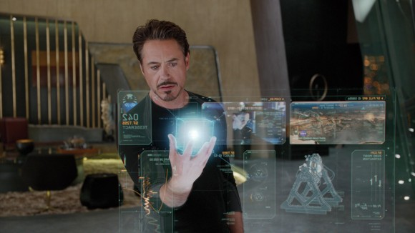
Gesture Recognition
Understanding human body language.
Interpret human interaction and use it as input to system.
Example move cursor according to hand movement. Or convert sign language to human speech.

Slide 3
Input devices
Vision based
Kinect
Leap Motion
Holo lens
Non vision based
Wired gloves
Myo

Slide 4
Leap Motion Controller
Launched in May 2013 (second version in 2014)
Tracks hand and figure movements in real time
Has two monochromatic IR cameras and three infrared LED
Synthesizes 3D position data of hands and fingers using the two cameras.
Small observational area but higher resolution.
Accuracy is 0.01mm

Slide 5
Project Description
Build a library for leap motion controller to recognize gestures in a 3D environment.
Implement mathematical models in efficient way.
Demo programs to showcase the recognized gestures.
Collect results and compare with existing models.

Slide 6
Gesture Classification
Action
Static
Simple – stop gesture
Dynamic
Changes with time – scroll gesture
Parametrized
Gestures with parameter – zoom gesture

Slide 7
Gesture Representation
3D model based
Volumetric model
Skeletal model
Appearance based
Color based
Binary Silhouette based
Motion based

Slide 8
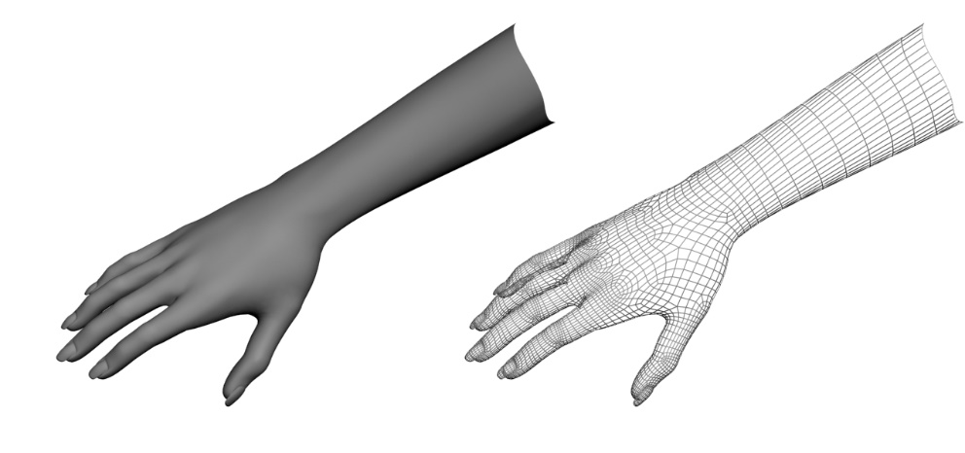
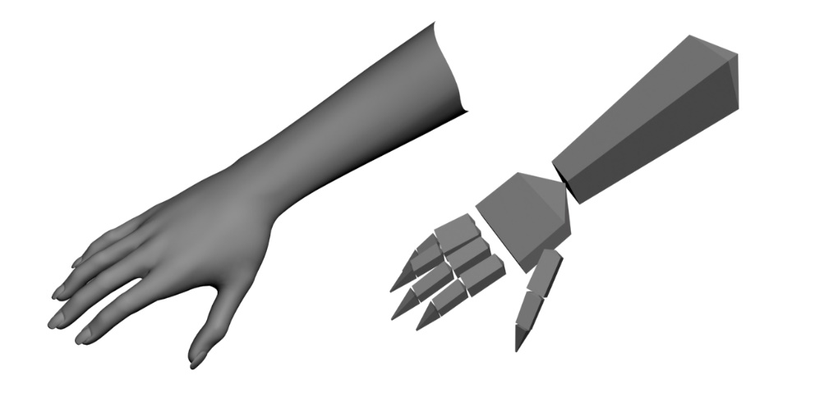
3D Model Gestures
Volumetric Based
Reproduce the shape of the object with high accuracy
Computationally expensive.
Skeletal based
Simplified representation of the object
Algorithms process faster
Easier to find the parameters in real time

Slide 9
Gesture Recognition Methods
Hidden Markov Model
Neural Networks
Support Vector Machines
Simple pattern Recognition Techniques
Finite state machines
Time delay neural network

Slide 10
Hidden Markov Model
Statistical model based on Markov’s property
Widely used (speech, gesture recognition)
The output is visible but not the states involved.
Used for dynamic gesture recognition.
Faster and accurate

Slide 11
Neural Network
Modeled after Human brain.
Set of neurons (Input, output, hidden).
Has set of weights associated with each neuron.
Weights are updated using a learning algorithm ( Training).
Activation function converts neurons weight into outputs (Recognition).
Used for both static and dynamic gestures.
Computationally expensive.

Slide 12
Milestone
Implement 2D mouse gestures
Left click, Right click, scroll, cursor movement
Implement mathematical model for simple gestures
Implement mathematical model for advanced gestures and demo program.

Slide 13
Design
Leap Motion Controller frames
Preprocessing
Model
(HMM,NN,SVM)
Output
(Recognized Gesture)

Slide 14
References
Wikipedia
Gesture Recognition: A Survey
Static hand gesture recognition using neural networks
Hidden Conditional Random Fields for Gesture Recognition
Hand gesture recognition using a real-time tracking method and hidden Markov models
Latent-Dynamic Discriminative Models for Continuous Gesture Recognition
Hand gesture recognition with leap motion and Kinect devices
Parametric hidden Markov models for gesture recognition

